Slide 1






Cash Dash Presented By: Trafton Boothby, Christie Djidjev, Andrew Bell, Matthew Chesser, Seamus O’Meara Date: 4/27/2023
Notes:
Background + Role

Slide 2

The Problem Pitch
The 350 Spectrum Warfare Wing (SWW) Financial Management (FM) Office currently needs a comprehensive system that provides insights into the planning, budgeting, and execution status of the organization.
Requested product - Establish a Business Management Dashboard that collects:
Budget positions, funded/unfunded requirements, Commander priorities, and contract tracking/status
Why?
To help decision-makers make informed decisions with allocated resources
Notes:
Christie presenting

Slide 3

First Steps & Initial Idea
Initial interviews + research to get familiar with FM
Possibility of an already existing/ implemented solution
Issues regarding ACC Dashboard
Our pivot
Training
Collaboration
Notes:
Christie presenting
After initial interviews and research, we were able to get familiar with the general FM system and possible solutions & roadblocks we may encounter
We found that there seemed to be a solution that was already in use - A Power BI dashboard created and maintained by Kermitt Francis
We eventually came to the conclusion that, while this dashboard did have much of the requested data/solutions, the ACC Dashboard was unintuitive, contracted to a single entity, and would require higher access levels for us to work with as well as the creation of a more extensive and specific training program
At this point we decided to forgo the training program angle and do our best with the permissions we have to create a mock-dashboard and live collaboration site to show how much time and money could be saved through a simple implementation of Teams-Integrated PowerBI and PowerApps through Sharepoint

Slide 4
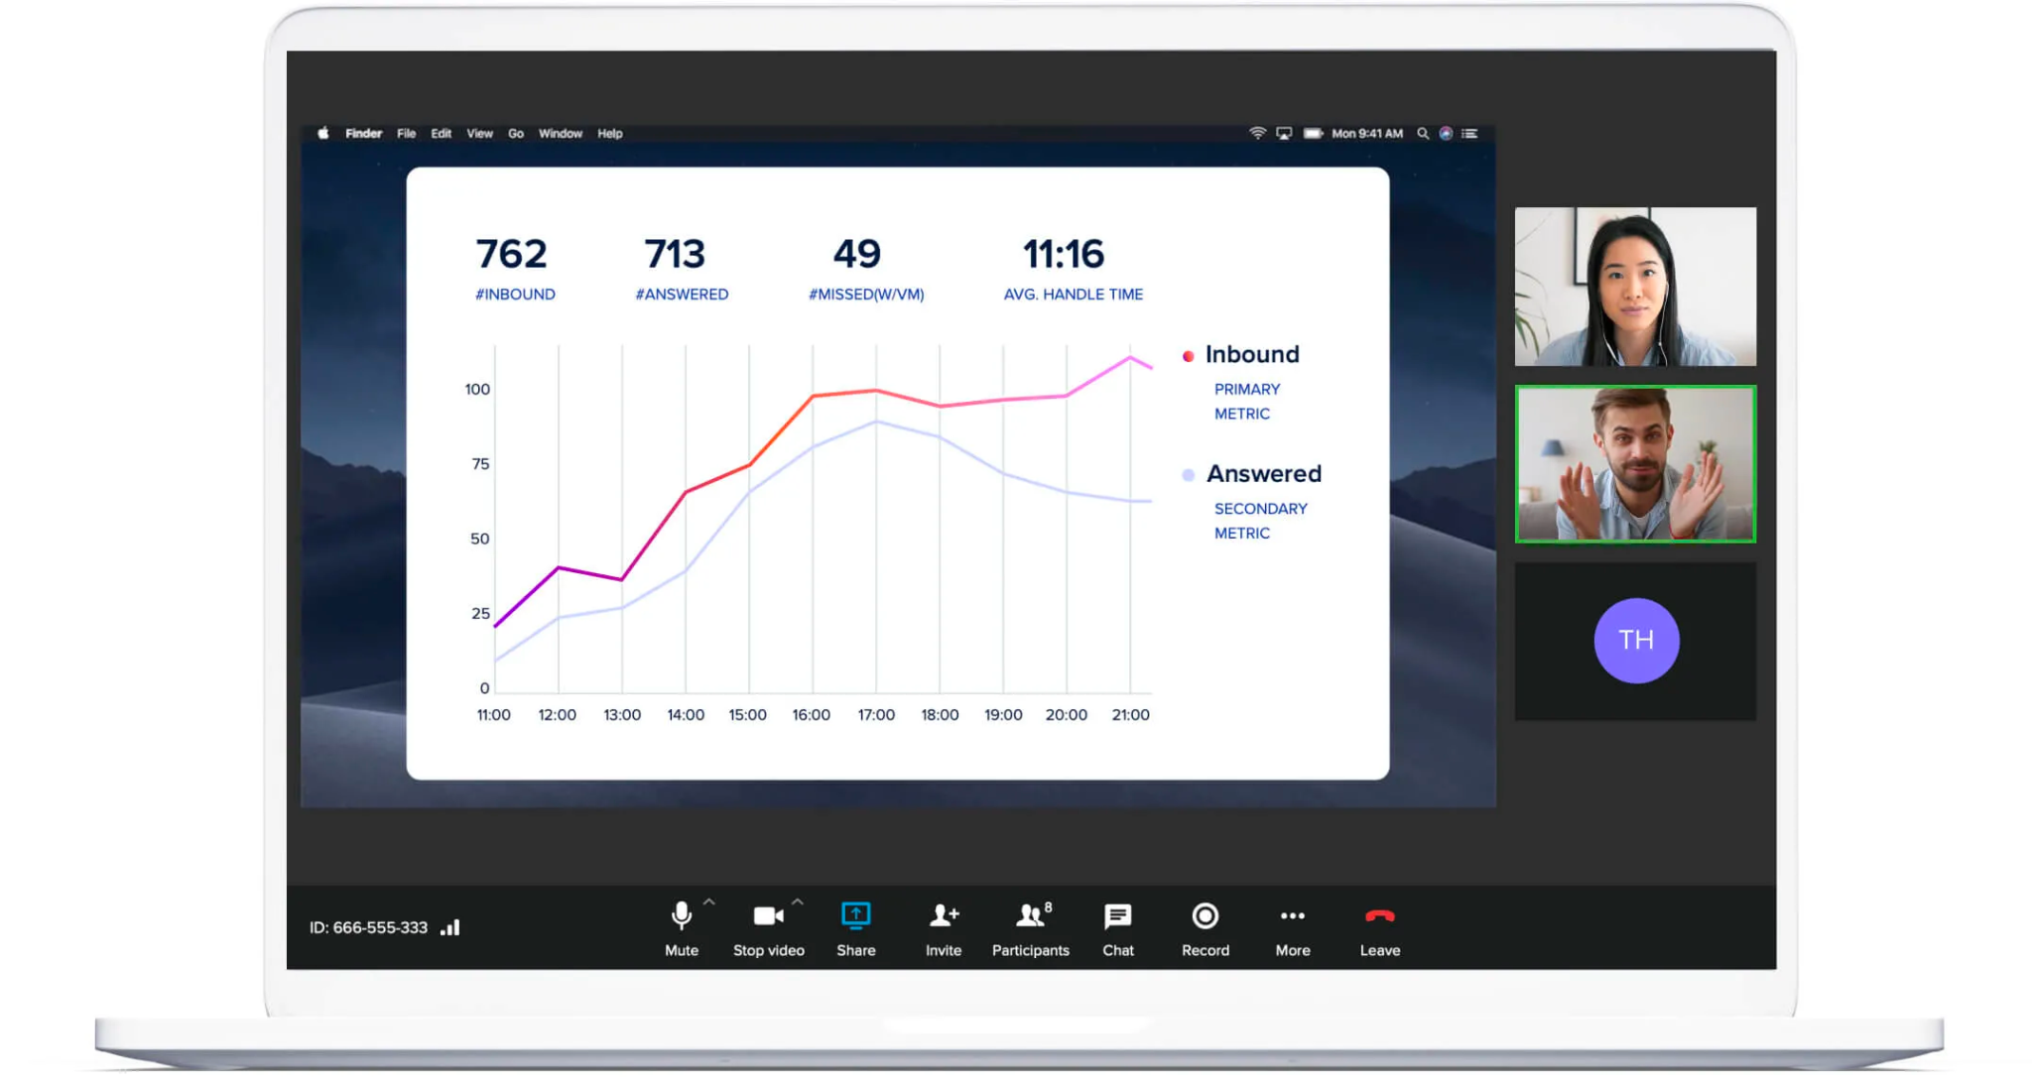
Interviews Conducted: 26
Zoom/Teams Interviews (Avg. of 30-90 minutes each): 22
E-mail Correspondence: 3
In-Person Interviews: 1
Interviewees included:
Jenna Hyde, Victoria Howes, John Hannah, Jerry Hernandez, Thomas Donigan, Kimberly Holder, Derek Hossbach, Trystan Link, Kermitt Francis, Christopher Orpilla, Elizabeth Raley, Joseph Clark, Breann Trager, Robin Newton, Elaine Boothby
Notes:
Trafton presenting
In-Person Interview:
Elaine Boothby (Family member)
15+ year FM/Sales worker
Gave further insight into the world of FM

Slide 5
Mentors & Their Affiliations
Mentors:
Problem Sponsor - Victoria L. Howes, Deputy Comptroller
Senior Leader - Jenna M. Hyde, Comptroller
Tech POCs:
Capt John Hannah, Flight Commander, Software Development
Christopher Orpilla, Data Officer, Contracted

Slide 6
A Few Key Individuals
Key Beneficiaries
Jenna Hyde - Comptroller / Senior Leader
Victoria Howes - Deputy Comptroller / Problem Sponsor
They wanted a new Dashboard to fit the specific needs of each section of the 350 SWW’s FM Team
FM Resource Advisors (RAs)
Struggles with collaboration & annoying data access permissions
Christopher Orpilla - Tech Expert + Support
Has been a great resource for information on the systems that the SWW uses
Showed us how/where available data & systems could be used in our solution
Notes:
Andrew presenting
They wanted a new Dashboard to fit the specific needs of each section of the 350 SWW’s FM Team
What they currently use and what they need
They struggled with collaboration (spreadsheets), so we want to provide them with a more efficient and user-friendly way to work together in real-time on crucial and time-sensitive financial data
Mr. Orpilla has supported us a lot; he has been a great resource for information on the systems that the SWW uses (CRIS and DEAMS, the dashboard they primarily use is overseen by TekSouth) and how/where available data & systems could be used in our solution

Slide 7

Universal Market & Business Features
A comprehensive dashboard can help financial teams to identify funding gaps, prioritize investments and make data-driven decisions
A couple of ways it can help save time and resources:
Real-time collaboration, quickly identify the spending trends, inconsistencies, etc.
User-based access controls - initial permissions, no need to give/receive permissions every time
Automating manual tasks, e.g. data entry or report generation
Notes:
Andrew presenting
The dashboard solution isn’t exclusive to just the air force FM
Some key features that can be universal to any organization
Real time collaboration: save time and resources. No time wasted on sending documents back and forth
User-based access controls: no need to to give/receive permissions every time an individual user needs to access or change something

Slide 8

Our Trajectory
Enthusiasm:
Improving the 350 SWW FM office’s planning, budgeting, and execution processes
Frustration:
Late swap to new Problem (Data->Cash)
Multiple pivots
Scheduling
Finding Our Pace:
Learned more about DoD practices/behavior
Gained experience with various Microsoft tools
Settling In:
Eventually settled on a hybrid solution pulled from our initial ideas:
Incorporate feedback and insight from different stakeholders
Leverage the practicality of Microsoft Tools
Notes:
Christie presenting
Frustration:
Stakeholders including the financial management team and resource advisors
“Late swap to new Problem (Data->Cash)” - we swapped to cashdash from data dash about a month into the class so we started behind schedule
Learning:
“Spoke to FM wing members including and the resource advisors about DoD practices and behavior” - can you be more specific? what practices & behavior did we learn? why did that help?
Gained insight into the various roadblocks and setbacks experienced using the current dashboard such as miscommunications that result in inaccurate or outdated information
Insight:
For instance, Kermitt Francis enlightened us that the solutions we were seeking are already integrated into Microsoft tools.

Slide 9
Client Feedback
“We don’t want a dashboard, we are requesting a [working, business management] tool… being able to link the PowerBI dashboard to our tool is important” - Victoria Howes, 3/22
“I think you are absolutely right with that ‘cause at the end of the day, it’s about the user. It’s about what we can do to help the end user” - Kermitt Francis, 3/13
“I don’t want you guys to get caught in between a sales pitch and people going against each other” - Jenna Hyde 3/15
“Using that tool, not reinventing the wheel, but creating our own from that” - Jenna Hyde 3/15
Notes:
Christie presenting
We found from speaking with the RAs that they would love the implementation of a more user friendly way to collaborate in real time. Later we go more in depth on the time/money saving estimates with our solution.RA Elizabeth Raley had used Microsoft Teams for cloud collaboration at their previous wing and it worked great

Slide 10
Workflow Comparison Chart
Current vs. Revised
Notes:
Trafton presenting

Slide 11
Current Data Update Process
Pull & Upload Data
5
Finalized & Re-Uploaded
1
4
Analyst Download & Review
RAs Filter/Update Spreadsheets
2
3
Re-Upload to LCMP
Revised Data Update Process
Comptroller & Analyst Review
3
Automated Notification
1
2
RAs Filter/Update Necessary Parts Only
Notes:
Trafton presenting

Slide 12
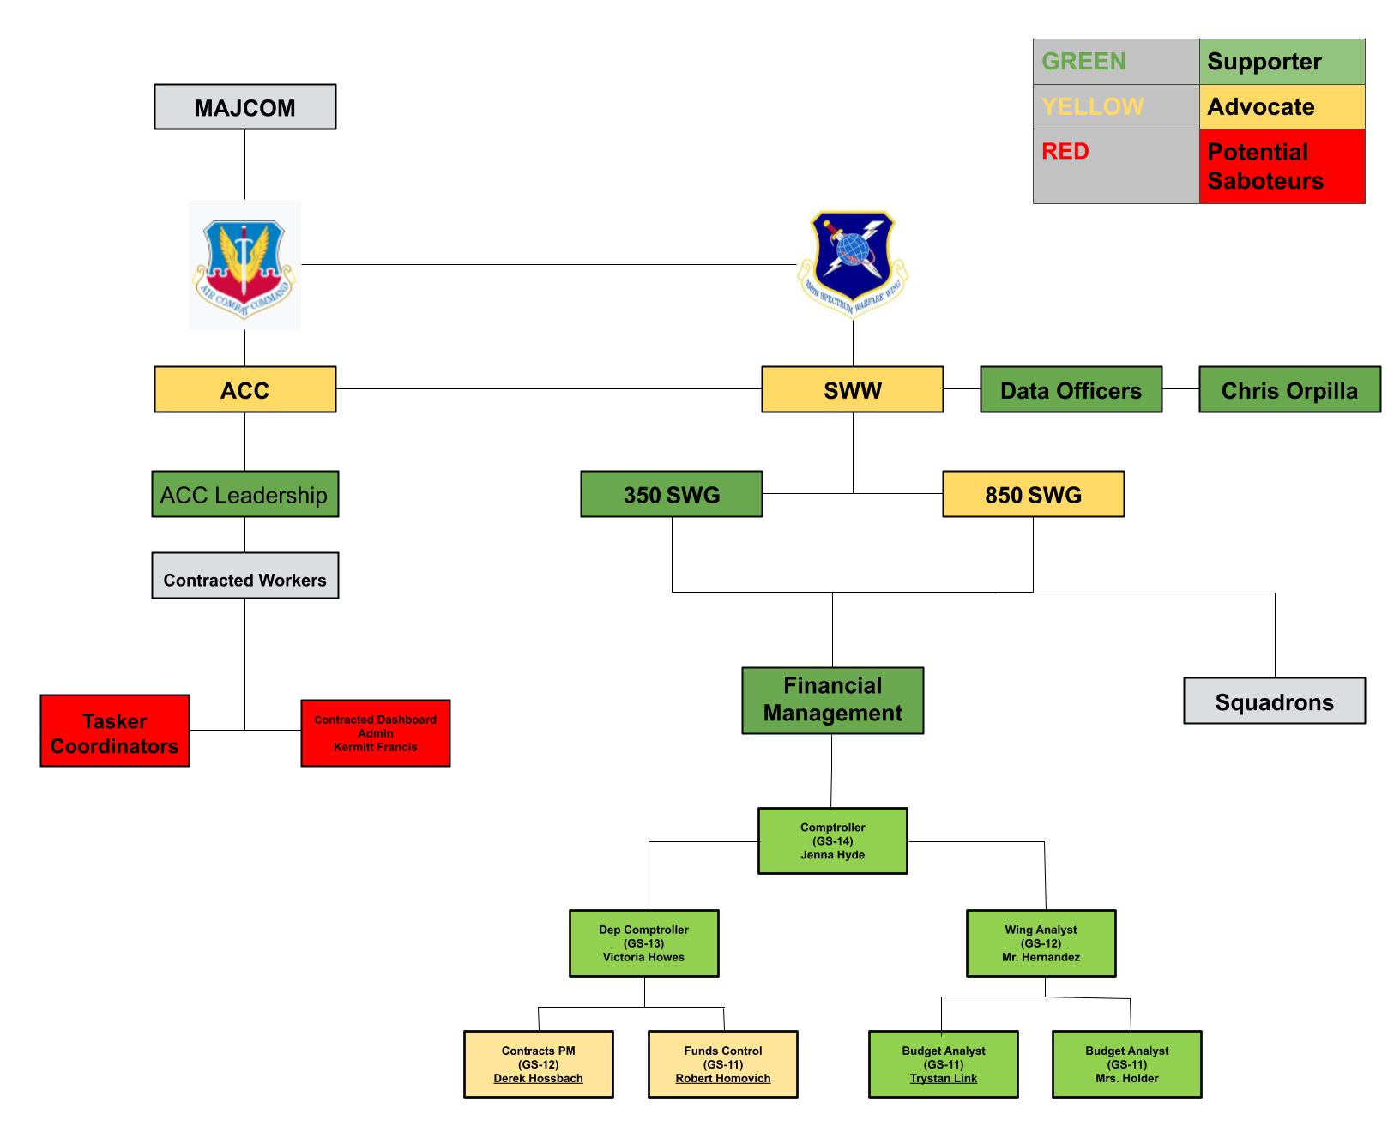
Our Revised Org-Chart
Notes:
Trafton Presenting
just briefly mention that we gathered information on their organization and revised/condensed it into an org chart that was more relevant for our purposes

Slide 13
Beneficiary Update
What did we learn from our Interviews?
What we wanted to learn
What does the data pipeline look like? How much time is saved? What are the cost/benefit/budget allocations?
What we learned
FM Workers’ median salaries, converted to hourly wages for cost/benefit calculations
General/vague data pipeline
more workflow & time-save specifics
How did this change things?
Continue testing MVP, researching requirements, creating visualizations + Creation of a theoretical Dashboard
Action Items
More Teams and SharePoint testing
Refine MVP w/ Orpilla (Create example dashboard hosted on an example SharePoint Site)
Refine budget/funding requirements for our MVP

Slide 14
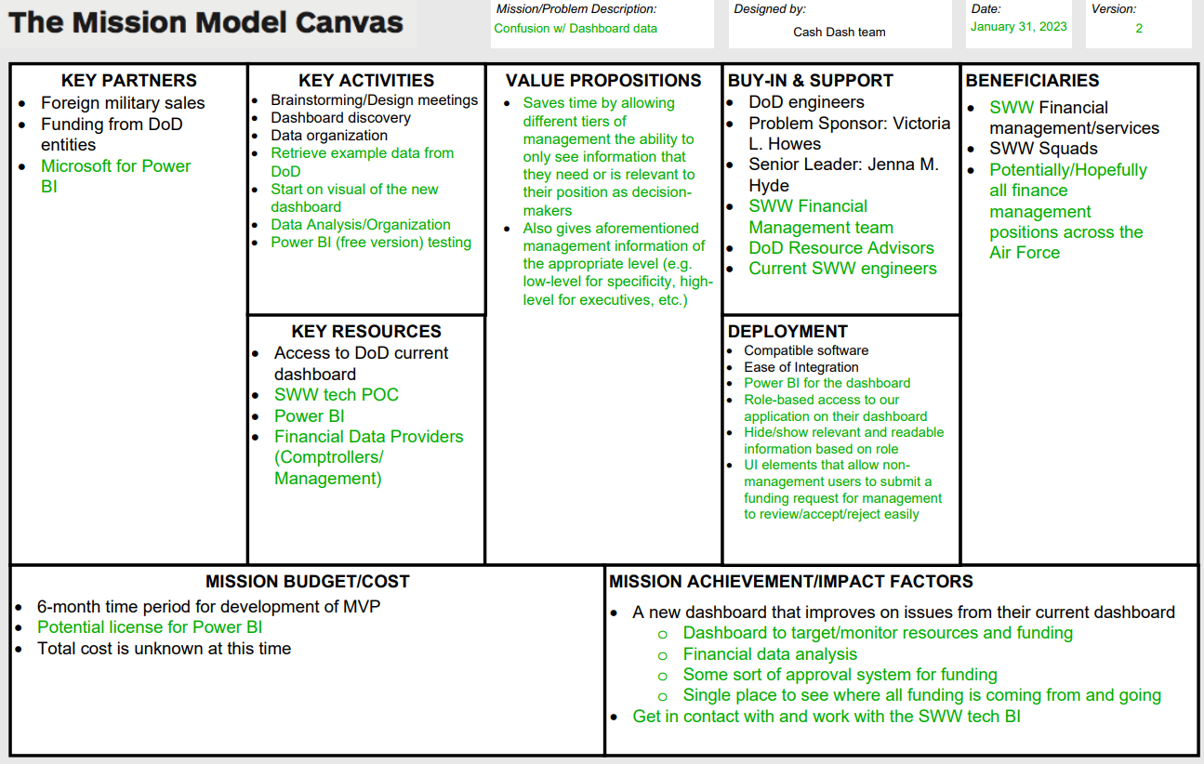
Initial MMC
Notes:
Andrew Presenting
A way to organize all of our key mission information & goals as they evolve over time through the project
Barren and broad beneficiaries
While this looks like a lot, it’s actually pretty vague overall. You’ll see that after we gained more information and a better understanding, we were really able to hone in on some of the more important parts of our mission.
Focus on the value propositions (gains for the beneficiaries), buy-in and beneficiaries as they were the most significant categories and changes
How these changed from what we had initially
Our value propositions were initially focusing on building a brand new dashboard to fit the needs of FM. We later shifted away from these value propositions as we discovered more
“Here was our original idea”

Slide 15
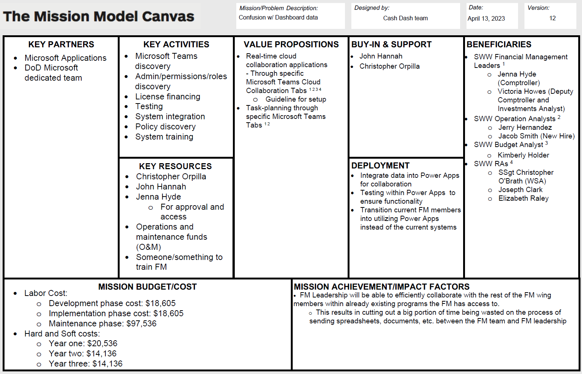
Final MMC
Notes:
Andrew Presenting
Focus on the value propositions, buy-in and beneficiaries as they were the most significant categories and changes
How these changed from what we had initially
Our value propositions were initially focusing on building a brand new dashboard to fit the needs of FM. We later shifted away from these value propositions as we discovered more
The budget encompasses the key activities
Mission achieved when our MVP is successfully deployed and allows the higher ups to make more well informed decisions and carry out missions efficiently with less missions stoppage
“Here was final idea”

Slide 16
What we did initially
We focused on discovering more about their current dashboard
Using that information to create a new dashboard focused specifically on the 350th SWW
Role-based access implementation
Hiding/showing prioritized data
Filter options that were more user friendly
Notes:
Matt presenting
Leads directly into the next slide

Slide 17

Initial MVP
MVPs for the week:
Possibility of Power BI Dashboard UI element implementation on SWW Power BI Dashboard
What is the MVP testing?
Possibility of time-saves from changes in UI regarding: Navigation, user-input, role-based access, and hiding/showing prioritized data
What data was expected?
Dashboard with filter options
What data was received?
Dashboard with filter options available (but possibly not utilized)
Notes:
Matt presenting
MENTION THAT WE DID NOT EVEN HAVE ANY DIAGRAMS/SOLUTIONS YET

Slide 18
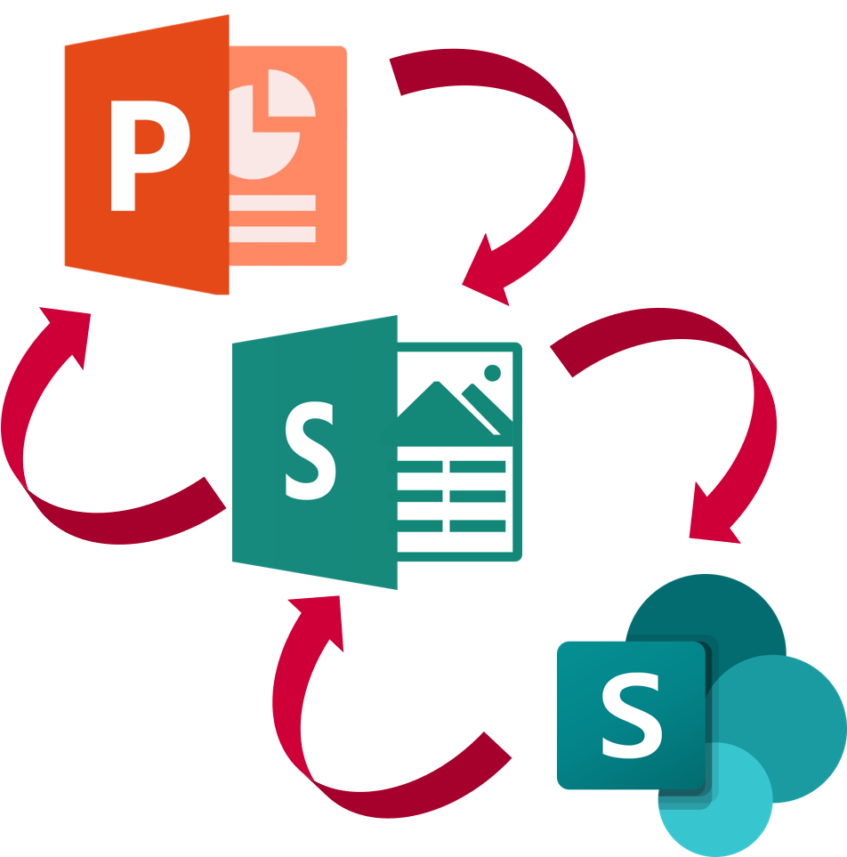
Current MVP Overview
Power Automate (PA) allows for automatic responses to events.
Creation/modification of key files can trigger a notification to key persons.
PA can be used to link directories.
Link a Page on Sharepoint to a Channel on Teams.
Link a List to an email (group or individual).
PA allows for virtually any process to be automated.
Events (called Flows) can be scheduled, automatic, instants, etc.
You decide the frequency of Flows, and the processes executed.
Notes:
Seamus presenting

Slide 19
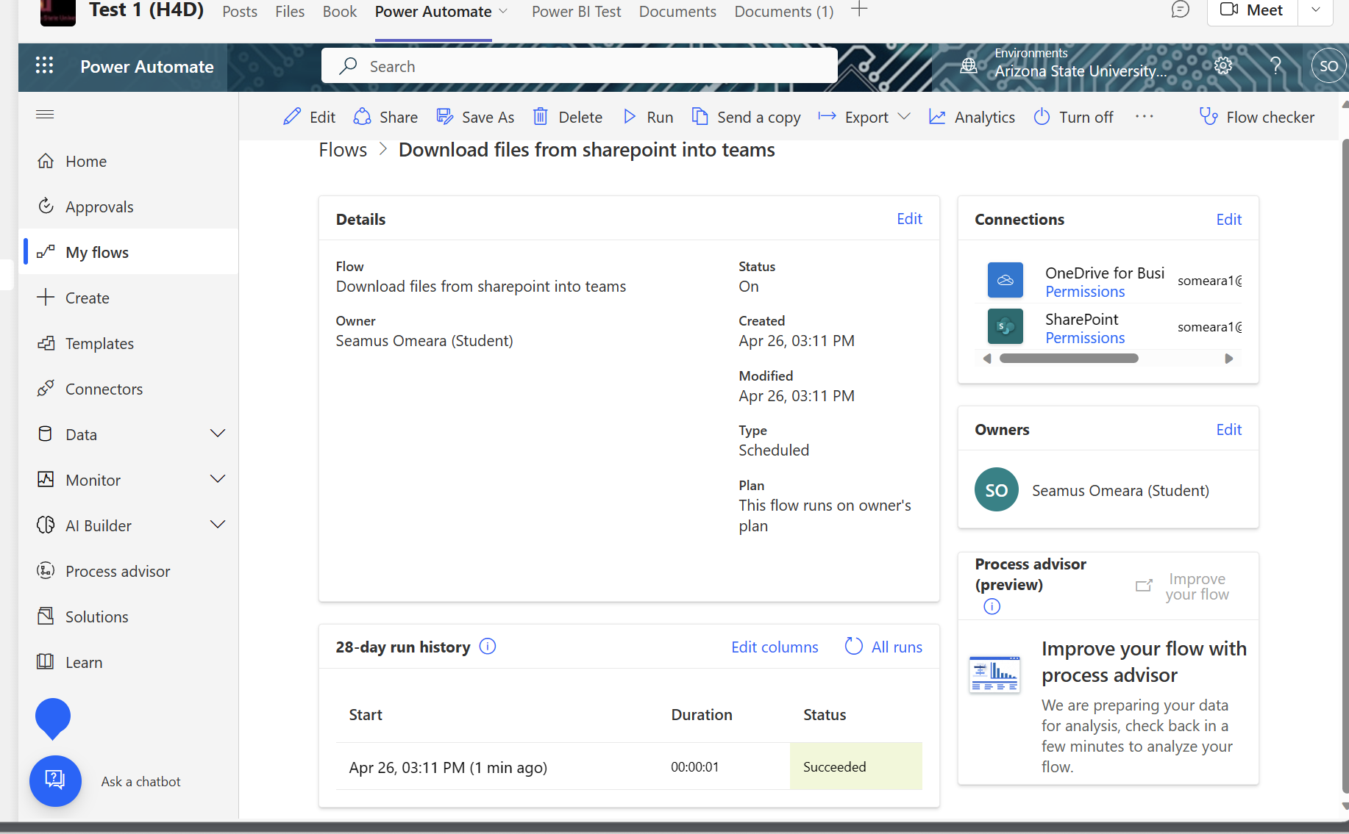
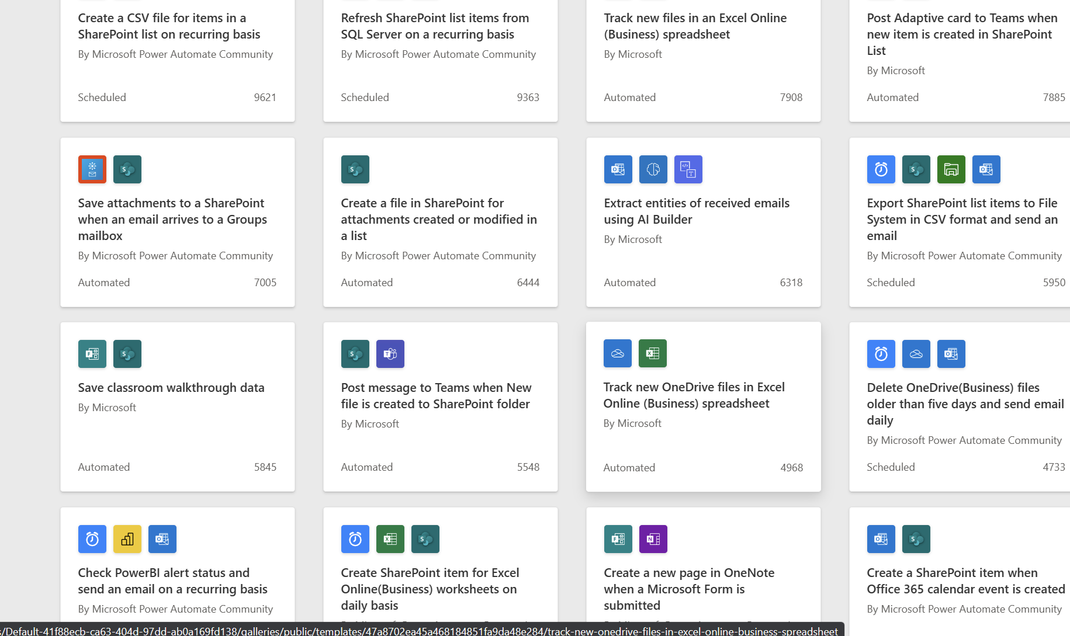
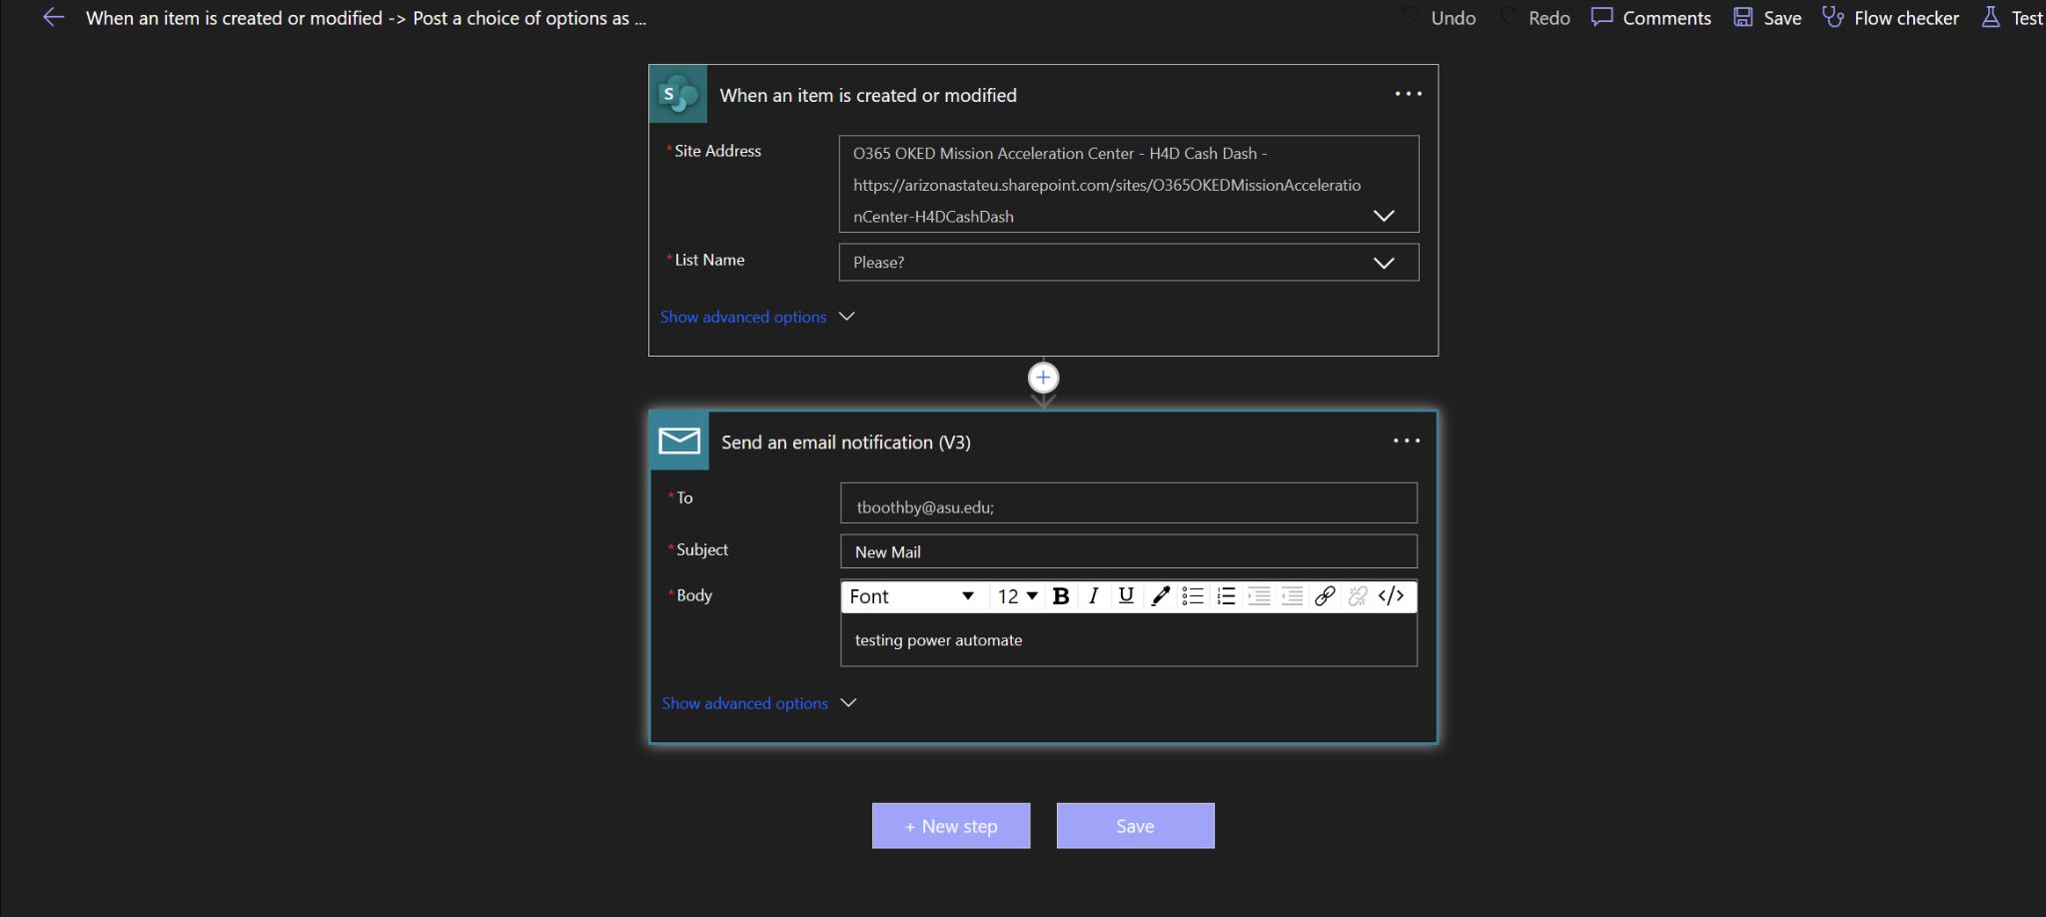
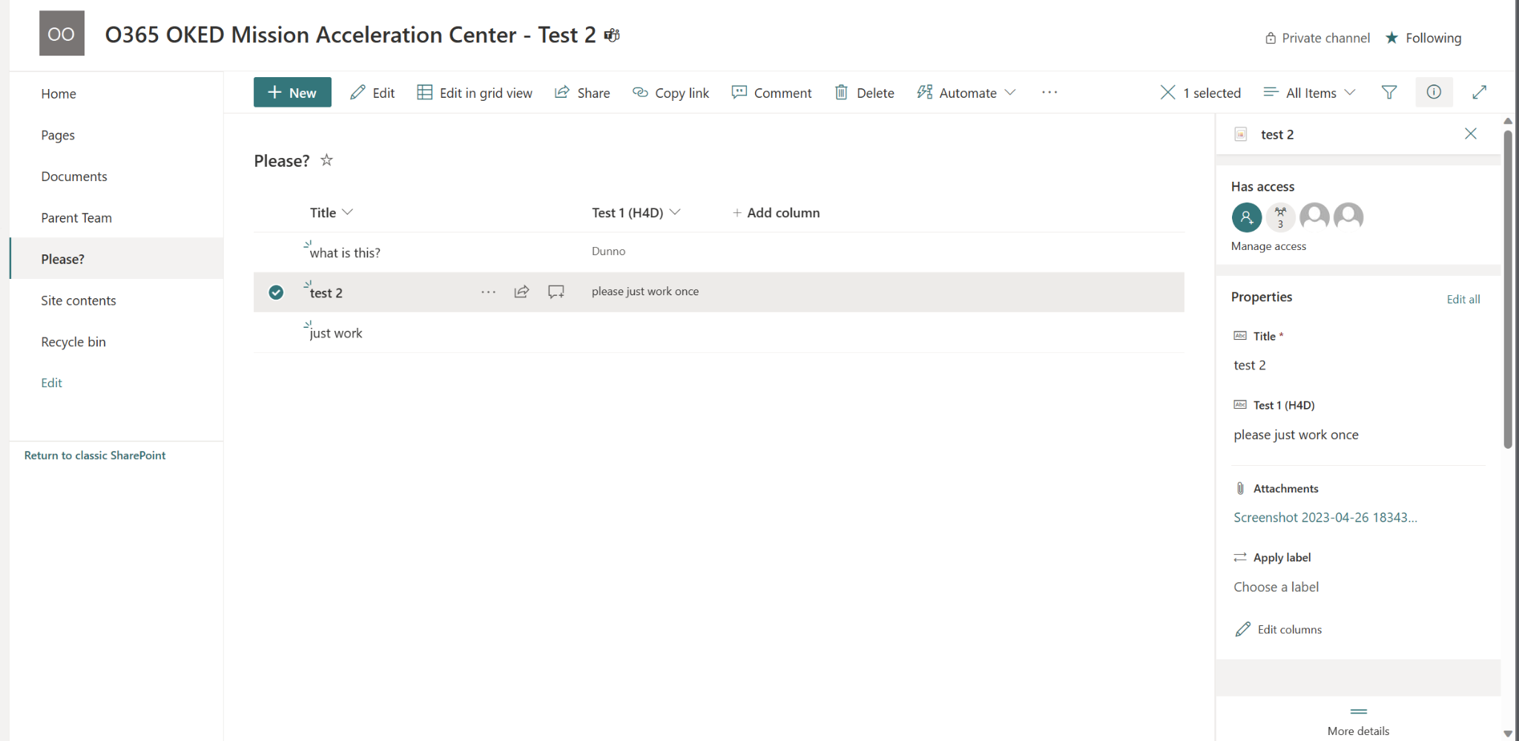
Power Automate has many premade flows that interact with SharePoint to choose from.
You can also create your own custom flow to suit your specific needs.
1
Power Automate allows you to create new flows that can respond to users actions.
PA Links to Sharepoint
2
3
Then sends an email to notify that a file has been added to Sharepoint.
When any of these lists are created or modified, Power Automate sends an email to a specified (number of) recipient(s).
Notes:
Seamus Presenting

Slide 20
SharePoint Process Map
Security
Automation
DEAMS/CRIS/etc Data Sources
Datasets Filtered for 350th Needs
Automated Upload to Site Library
Access Controls
Customizable & Personalized Visuals
SharePoint Site
Organized Pages
Can have different Wing/Group/Squad views
FM Requirements Page
FM Buy/Spend Plan Page
Real-Time Collaboration
Change-Logs
Role-Based Access
Funded Requirements file
Unfunded Requirements file
Buy Plan sheets
Spend Plan sheets
Notes:
Seamus and Matt

Slide 21
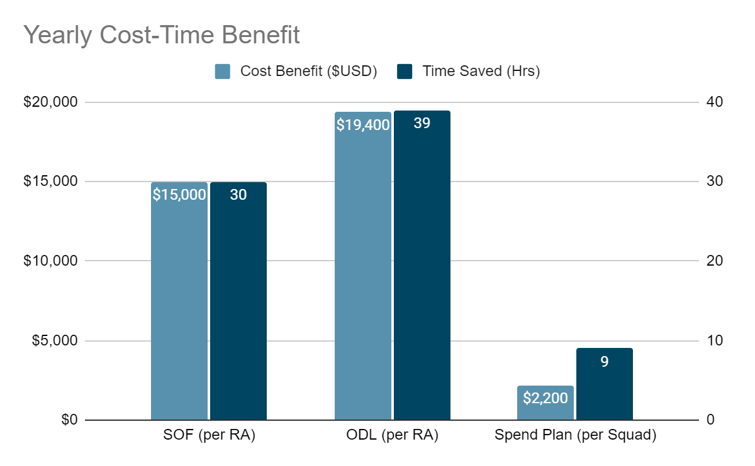
Notes:
Trafton presenting

Slide 22
Our Conclusions
More user-friendly process and front-end
Our MVP shows an example of what a more user-friendly and efficient implementation would look like (Teams/Sharepoint/Power Automate)
Power Automate would streamline the process of managing files across different applications and platforms.
FM’s data processing/collaboration issue
Microsoft Teams alleviates multiple time consuming processes
Teams provides quick links to folders, applications, and directories.
Notes:
Seamus Presenting
The 350th SWW already has a dashboard that does all of the things they want done -> The 350th SWW already has the capability to solve most of the FM’s wants but isn’t a user friendly experience
Knowing this we still tried to make a simple dashboard visual to show hypothetically what a new one would look like -> Knowing this we still tried to make a simple dashboard visual to show hypothetically what a new more friendly user experience one would look like
We made a visual to show the 350th SWW what a switch to Microsoft Teams for collaboration entails and the process of switching over -> We made a visual to show the 350th SWW what a switch to Microsoft Teams for collaboration entails and what the new data pipeline process would look like

